Slide 1
STRING PATTERN MATCHING

Slide 2
CONTENT
1

Slide 3
Content
Overview
Knuth-Morris-Pratt (KMP)
Rabin Karp
Quiz
Q&A

Slide 4

OVERVIEW
What is “String Pattern Matching”?
First concepts
Definitions

Slide 5
Overview
Searching for occurrences of a given pattern as a substring of larger text string.
This problem can be formulated as follows:
i
i + m - 1
T
n
1
m
S
m
Notes:
Cho chuỗi T có độ dài là n, chuỗi mẫu S có độ dài là m; m,n > 0 và m <= n
Nếu S là một chuỗi con trong T thì xác định vị trí xuất hiện của S trong T.
Trả về giá trị vị trí i nhỏ nhất mà y(i, i + m – 1) = x(1, m).

Slide 6
Example:
Input: txt[] = "AABAACAADAABAABA"
pat[] = "AABA"
Output: Pattern found at index 0
Pattern found at index 9
Pattern found at index 12
0
0 | 1 | 2 | 3 | 4 | 5 | 6 | 7 | 8 | 9 | 10 | 11 | 12 | 13 | 14 | 15
A | A | B | A | A | C | A | A | D | A | A | B | A | A | B | A
9
12
A | A | B | A
A | A | B | A
A | A | B | A
0 | 1 | 2 | 3
A | A | B | A

Slide 7
Naïve approach: Brute Force
Input: txt[] = "AABAACAADAABAABA"
pat[] = "AABA"
Output: Pattern found at index 0
Pattern found at index 9
Pattern found at index 12
txt → 16
0 | 1 | 2 | 3 | 4 | 5 | 6 | 7 | 8 | 9 | 10 | 11 | 12 | 13 | 14 | 15
A | A | B | A | A | C | A | A | D | A | A | B | A | A | B | A
pattern → 4
0 | 1 | 2 | 3
A | A | B | A
Window size: 4

Slide 8
0 | 1 | 2 | 3 | 4 | 5 | 6 | 7 | 8 | 9 | 10 | 11 | 12 | 13 | 14 | 15
A | A | B | A | A | C | A | A | D | A | A | B | A | A | B | A
A | A | B | A
A
A
B
B
A
A
A | C
C
C
A
A | D
A
D
D
A
A
A | B | A
B
B
A
A | B | A
0 | 1 | 2 | 3
A | A | B | A
0 | 1 | 2 | 3
A | A | B | A
0 | 1 | 2 | 3
A | A | B | A
0 | 1 | 2 | 3
A | A | B | A
0 | 1 | 2 | 3
A | A | B | A
0 | 1 | 2 | 3
A | A | B | A
0 | 1 | 2 | 3
A | A | B | A
0 | 1 | 2 | 3
A | A | B | A
0 | 1 | 2 | 3
A | A | B | A
0 | 1 | 2 | 3
A | A | B | A
0 | 1 | 2 | 3
A | A | B | A
0 | 1 | 2 | 3
A | A | B | A
0 | 1 | 2 | 3
A | A | B | A
A
A | A | B | A
A
A
A
A
A
A | B
A
A
A
A
A | B
A
A
A
A | B | A
A
A
A
A
A | B | A
Pattern is found at index 0
Pattern is found at index 9
Pattern is found at index 12

Slide 9
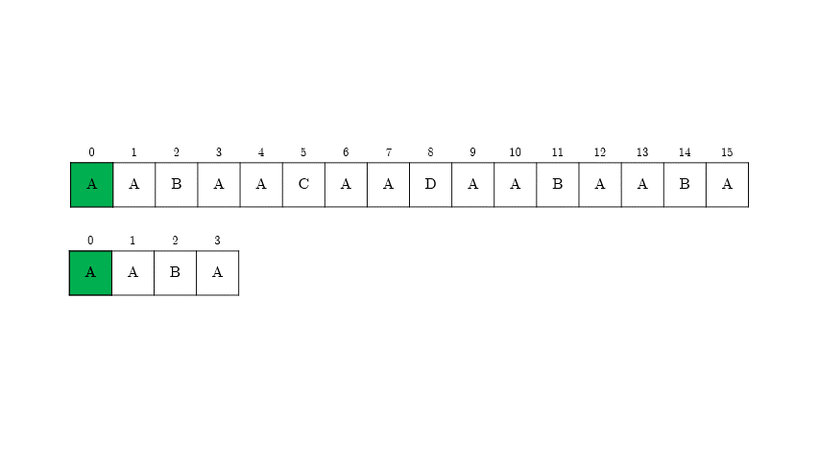

Can we avoid matching the characters that we know they will match anyway?

Slide 10
Example: Skipping Positions
0 | 1 | 2 | 3 | 4 | 5 | 6 | 7 | 8 | 9 | 10
A | B | R | A | C | A | D | A | B | R | A
A
A | B | R | A
B | R | A
0 | 1 | 2 | 3
A | B | R | A
A
A
R | A
B | R | A
B | R | A
A | B | R | A
0 | 1 | 2 | 3
A | B | R | A
0 | 1 | 2 | 3
A | B | R | A
0 | 1 | 2 | 3
A | B | R | A
A
A | B
A | B | R
A | B | R

Slide 11
Example: Skipping Positions
0 | 1 | 2 | 3 | 4 | 5 | 6 | 7 | 8 | 9 | 10 | 11
A | B | C | D | A | B | C | D | A | B | E | F
A | B | C | D | A | B
A | B
A | B
A | B | C | D | A | B | E | F
A | B
0 | 1 | 2 | 3 | 4 | 5 | 6 | 7
A | B | C | D | A | B | E | F
A | B
A | B
A | B | C | D | A | B
A | B | C | D | A | B | E | F
A | B
A | B

Slide 12
Example: Skipping Positions
0 | 1 | 2 | 3 | 4 | 5 | 6 | 7 | 8 | 9 | 10 | 11
A | B | A | B | A | B | A | B | A | B | E | F
A | B | A | B | A | B
A | B | A | B | A | B | E | F
A | B | A | B
A | B | A | B | A | B
A | B | A | B
0 | 1 | 2 | 3 | 4 | 5 | 6 | 7
A | B | A | B | A | B | E | F
0 | 1 | 2 | 3 | 4 | 5 | 6 | 7
A | B | A | B | A | B | E | F
A | B | A | B | A | B
A | B | A | B
A | B | A | B
A | B | A | B
A | B | A | B
A | B | A | B | A | B | E | F
A | B | A | B | A | B

Slide 13
Definitions:
String X is a substring of string Y when X is a sequence of consecutive characters of Y.
String X is a prefix of string Y when X is a substring of Y and X presents at the beginning of Y.
X is a proper prefix of Y if X is a prefix of Y and different from Y.
String X is a suffix of string Y when X is a substring of Y and X presents at the end of Y.
X is a proper suffix of Y if X is a suffix of Y and different from Y.

Slide 14
T = | a | b | c | b | c | a | b
a | b | c | b
a | b | c | b | c | a
a | b | c | b | c | a | b
a | b
a | b | c | b | c | a | b
a
a | b | c
a
a | b | c | b | c | a | b
b | c | b | c | a | b
c | b | c
b | c | a | b
c | a | b
b
b
Substring:
Prefix:
Proper prefix:
Suffix:
Proper suffix:
a | b
c | b | c
a | b | c | b | c | a | b
a
a | b | c
a | b | c | b | c | a | b
a
a | b | c | b
a | b | c | b | c | a
b
c | a | b
a | b | c | b | c | a | b
b
b | c | a | b
b | c | b | c | a | b

Slide 15
Border of string T is a prefix of T which is equal to a suffix of T, but not equal to the whole T.
E.g:
T = | a | r | b | a | “a” is a border
S = | a | b | c | d | a | b | “ab” is a border
X = | a | b | a | b | a | b | “abab” is a border
Y = | a | b | “ab” is not a border

Slide 16
KNUTH – MORRIS – PRATT (KMP)
Original idea.
How to get “safe shift”?
What is prefix function?

Slide 17

Knuth – Morris – Pratt (KMP)
The original idea, due to Morris and Pratt, is:
 |  |  |  |  |  | T
 |  | U
W
W
 |  | U
 |  |  | P
W
W
Find the longest common prefix U.
Find W – the longest border of U.
Move P such that prefix W in P aligns with suffix W of U in T.

Slide 18
Now we know how to skip some of the comparisions.
But we shouldn’t miss any of the pattern occurrences in the text.
Is it safe to shift the pattern this way?

Slide 19
Knuth – Morris – Pratt (KMP)
Safe shift:
U is the longest common prefix of P and suffix T_{k}.
W is the longest border of U.
Then there are no occurrences of P in T starting between positions k and
(k + |u| - |w|) – the start of suffix W in the prefix U of T_{k}.
 | U
W
W
 |  |  |  |  |  | T
 | U
 | U
 |  |  | P
W
W

Slide 20
Safe shift:
k
i
T
 | V
 | P
W | U | W
 |  |  |  |  |  | T
 | V
U | V
P
 | U
 |  |  | P
Proof:
P occurs in T in position i between k and start of suffix W.
Then there is prefix V of P equal to suffix in U, and V is longer than W.
Because V is a border longer than W, but W is the longest border of U, which leads to contradiction.

Slide 21
Now we know it is possible to avoid many of the comparisions which naïve approach (Brute Force) algorithm does.
But how to determine the best pattern shifts?

Slide 22

Knuth – Morris – Pratt (KMP)
Prefix function:
Prefix function of a string P is a function s(i) that for each i returns the length of the longest border of the prefix P[0..i].
A boundary condition for s(0) is s(0) = 0.
Consider below example:
i | 0 | 1 | 2 | 3 | 4 | 5 | 6 | 7 | 8 | 9
P | a | b | a | b | a | b | c | a | a | b
s(i) | 0 | 0 | 1 | 2 | 3 | 4 | 0 | 1 | 1 | 2
Notes:
Điều kiện ràng buộc cho f(0) là để cho chắc chắn rằng hậu tố dài nhất phải là một hậu tố không tầm thường.

Slide 23

i | 0 | 1 | 2 | 3 | 4 | 5 | 6 | 7 | 8 | 9
P | a | b | a | b | a | b | c | a | a | b
s(i) | 0 | 0 | 1 | 2 | 3 | 4 | 0 | 1 | 1 | 2
a | b
c
0
a
a
a
a | b | a | b | a | b
a | b
a | b | a | b | a
a | b
a | b
a
a
a
a
0
b
0
1
2
3
4
1
1
2

Slide 24

Knuth – Morris – Pratt (KMP)
Prefix function:
Properties: P[0..i] has a border of length s(i + 1) – 1.
Proof:
0
i
i + 1
w’
w
w’
w
Take the longest border w of P[0..i + 1].
Cut the last character from w it’s a border of P[0..i] now.
Corollary: s(i + 1) ≤ s(i) + 1

Slide 25
Knuth – Morris – Pratt (KMP)
Prefix function:
Enumerating borders:
If s(i) > 0, then all borders of P[0..i] but for the longest one are also borders of P[0..s(i) − 1].
0
i
u |  |  |  | u
 |  |  |  | u
s(i)
s(i)

Slide 26
Enumerating borders:
If s(i) > 0, then all borders of P[0..i] but for the longest one are also borders of P[0..s(i) − 1].
Proof:
0
i
u
u
u
s(i)
s(i)
Let u be a border of P[0..i] such that |u| < s(i).
Then u is both a prefix and a suffix of P[0..s(i) − 1].
u ≠ P[0..s(i) − 1], so u is a border of P[0..s(i) − 1].

Slide 27
Enumerating borders:
All border of P[0..i] can be enumerated by taking the longest border b₁ of P[0..i], then the longest b₂ of b₁, then the longest border b₃ of b₂, …, and so on.

Slide 28

Knuth – Morris – Pratt (KMP)
Prefix function:
Computing s(i + 1):
0
i
i + 1
x
x
x
x
s(i)
s(i)
s(i + 1)
s(i + 1)
s(i + 1) = s(i) + 1

Slide 29
Knuth – Morris – Pratt (KMP)
Prefix function:
Computing s(i + 1):
0
i
i + 1
 | x
y
x
x
y
x
s(i + 1)
s(i + 1)
s(i)
s(i)
s(i + 1) = |some border of P[0..s(i) − 1]| + 1

Slide 30
Now you know lots of properties of prefix function.
But how to compute all of its value?

Slide 31

Knuth – Morris – Pratt (KMP)
Computing Prefix function:
i | 0 | 1 | 2 | 3 | 4 | 5 | 6 | 7 | 8 | 9
P | a | b | a | b | a | b | c | a | a | b
f(i)
c
c
a
c
a
a
b
a
b
c
a
a | b
a
a | b
b
a
a | b
a
b
a
a
b
a
b
a
b
b
a
a
b
a | b
a
a
a | b | a | b
a
b
a
a
a
b
a | b | a
0
0
1
2
3
4
0
1
1
2

Slide 32
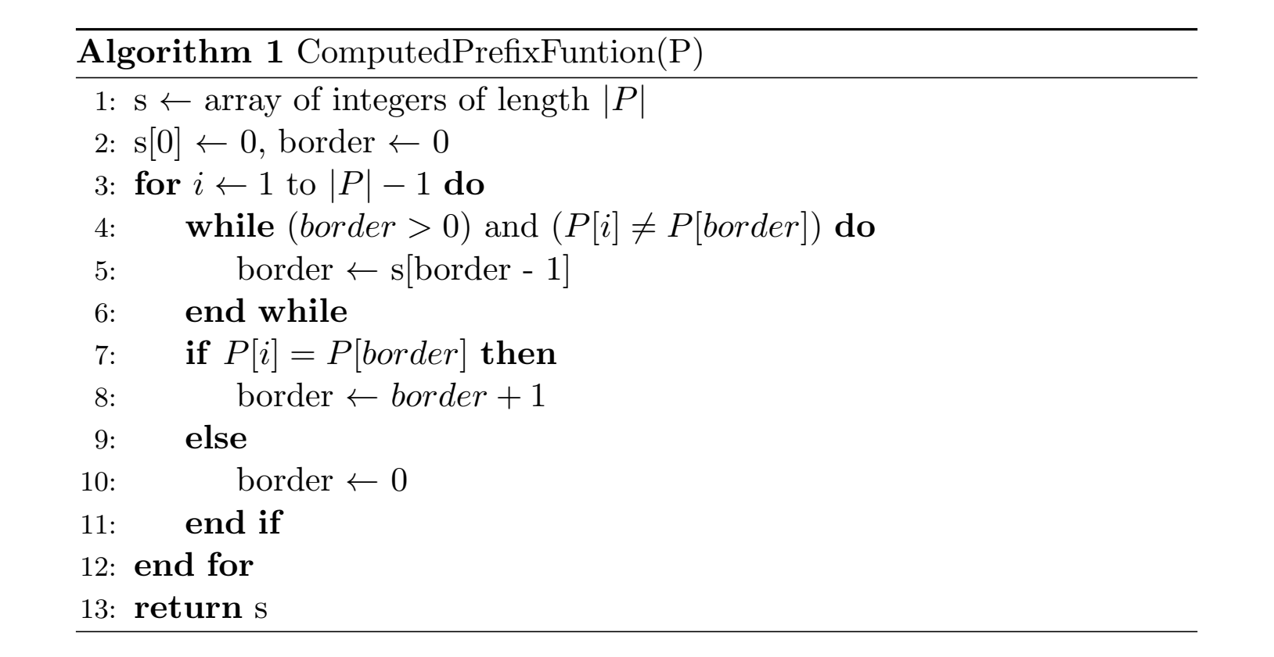

Slide 33
Now you know how to compute the longest proper prefix.
But what does it do in KMP?

Slide 34
Knuth – Morris – Pratt (KMP)
1
2
3
4
5
6
7
8
9
10
i | 0 | 1 | 2 | 3 | 4 | 5 | 6 | 7 | 8 | 9 | 10
T | A | A | A | A | A | B | A | A | A | B | A
0
i | 0 | 1 | 2 | 3 | 4 | 5 | 6 | 7 | 8 | 9 | 10
T | A | A | A | A | A | B | A | A | A | B | A
A | A | A | A
B
A
A
A
B
A
A
A
A
A
A
A | A | A | A
0
0 | 1 | 2 | 3
A | A | A | A
0 | 1 | 2 | 3
0 | 1 | 2 | 3
A | A | A | A
0 | 1 | 2 | 3
1
0 | 1 | 2 | 3
A | A | A | A
0 | 1 | 2 | 3
0 | 1 | 2 | 3
A | A | A | A
0 | 1 | 2 | 3
1
2
3
0
0
j | 0 | 1 | 2 | 3
P | A | A | A | A
lps | 0 | 1 | 2 | 3
2
0 | 1 | 2 | 3
A | A | A | A
0 | 1 | 2 | 3
0 | 1 | 2 | 3
A | A | A | A
0 | 1 | 2 | 3
0 | 1 | 2 | 3
A | A | A | A
0 | 1 | 2 | 3
3
3
3
j | 0 | 1 | 2 | 3
P | A | A | A | A
lps | 0 | 1 | 2 | 3
0 | 1 | 2 | 3
A | A | A | A
0 | 1 | 2 | 3
j | 0 | 1 | 2 | 3
P | A | A | A | A
lps | 0 | 1 | 2 | 3
0
0
0 | 1 | 2 | 3
A | A | A | A
0 | 1 | 2 | 3
1
2
2
1
0 | 1 | 2 | 3
A | A | A | A
0 | 1 | 2 | 3
Input: txt[] = "AAAAABAAABA"
pat[] = "AAAA"
Output: Pattern found at index 0
Pattern found at index 1
A
A
A
A
A
A
A
A
A
A | A | A
A
A
A
A
A
A
A
A
1
3
0
3
2
2
0
1
j = lps[j – 1]

Slide 35
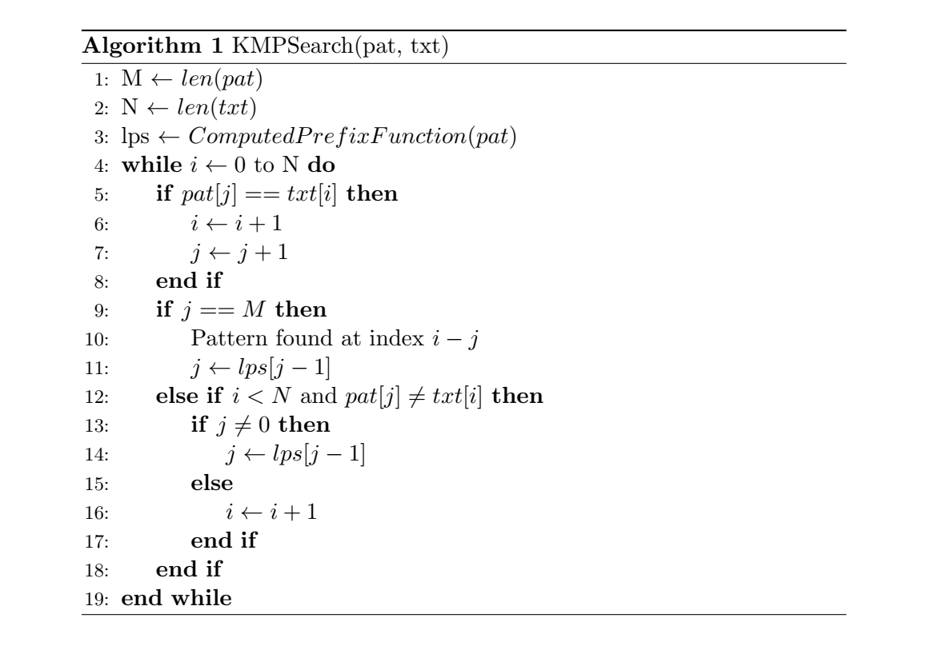

Slide 36
Knuth – Morris – Pratt (KMP)
Time complexity:
Let m, n respectively be size of pattern string and main string.
Method | Time Complexity | Space Complexity
computedPrefixFunction() | O(m) | O(m)
KMPSearch() | O(n) | O(1)
The first method “computedPrefixFunction()” contains a while loop that runs m times. It also requires additional array to store lps of size equal to pattern size.
The second method “KMPSearch()” just compares pattern through the entire main string of length n using a while loop.
Thus we can see that the total time complexity of KMP is O(m + n) which is a linear time complexity.

Slide 37



Knuth – Morris – Pratt (KMP)
KMP’s application:

Slide 38
PROS
CONS
1
It’s guaranteed worst-case efficiency as discussed.
Running time is optimal
Doesn’t work so well as the size of alphabets increases.
1
2
The algorithm never needs to move backwards in the input text.
Good for processing very large files.
Processing very large files it also requires resources in the form of processors
2

Slide 39
RABIN KARP
Rolling hash
Hash function
Pseudocode

Slide 40
RABIN KARP
Rolling hash:
A rolling hash to be computed very quickly - the new hash value is rapidly calculated given only the old hash value.
O(1) time per hash.

Slide 41
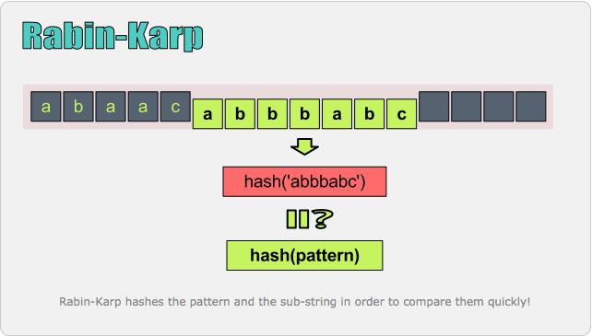

Slide 42
0 | 1 | 2 | 3
A | A | B | A
Hash(‘AABA’) = value
0 | 1 | 2 | 3 | 4 | 5 | 6 | 7 | 8 | 9 | 10 | 11 | 12 | 13 | 14 | 15
A | A | B | A | A | C | A | A | D | A | A | B | A | A | B | A
A | A | B | A
B | A | A | C
A | B | A | A
A | A | B | A
........
Hash(‘AABA’)
Hash(‘AABA’)
Hash(‘ABAA’)
Hash(‘BAAC’)
Comparing each Hash value of text to Hash value of pattern.
If they are equal then matching each character with pattern.
42

Slide 43
RABIN KARP
A good hash function has to be satisfied 2 factors:
Basic operations perform effectively.
When hashing two different substrings of the same length m, the probability that the two hashes are the same is small.
Karp-Rabin proposed to choose a hash function H_{q} randomly (hash function modulo q) from a family of hash functions:
H = {H_{q} | q is a prime number ≤ [m² log m]}

Slide 44
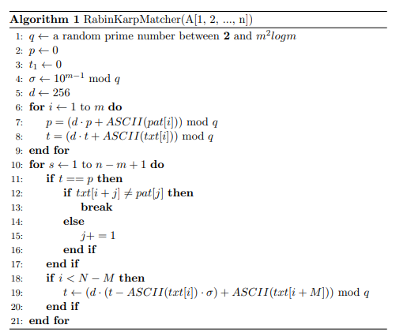

Slide 45
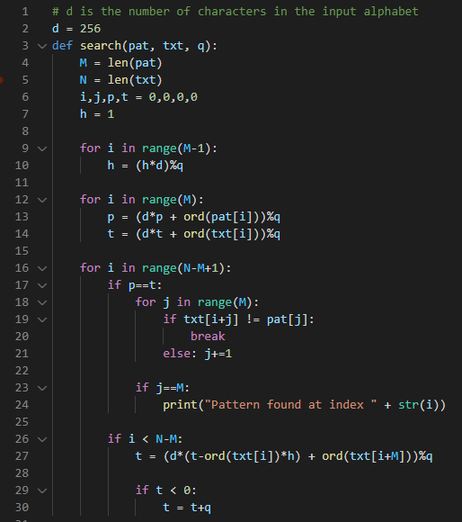
txt = “TanUIT”
pat = “an”
q = 11
M = 2, N = 7
h = 3
p = 5 , t = 8
M = 2, N = 7
h = d^{m-1} % q = 256²⁻¹ % 11 = 3
t = (256*(8 - 84*3) + 110) % 11 = 5
i = 0: p = (256*0+97)%11 = 9
t = (256*0+84)%11 = 7
t == p :
#Check for characters one by one
i = 1: p = (256*9+110)%11 = 5
t = (256*7+97)%11 = 8

Slide 46
RABIN KARP
Let F be the set of substrings of T of length m and the same hash value as P.
It takes O(m) time to compare whether the substring is P or not.
It takes O(n) time to compute p, t₁, t₂, …t_{n-m+1}
Best and average: O(n+|F|.m) = O(n+m)
Worst: O(n.m)
The worst case occurs when all hash values of substring t are the same with p.
Vd: txt = “AAAAAAAAA”
pattern = “AAA”

Slide 47
Need to find a good Hash function to avoid unnecessary collisions.
Easy to implement
Pros
Cons
Alternative method
Execution time is relatively fast.
The more mod operator the more slowly

Slide 48
RABIN KARP
Application:
A practical application of the algorithm is detecting plagiarism. Given source material, the algorithm can rapidly search through a paper for instances of sentences from the source material, ignoring details such as case and punctuation. Because of the abundance of the sought strings, single-string searching algorithms are impractical..

Slide 49
IDEAS
SLIDE
PRESENTER
DEMO
Cả ba đều đóng góp và xây dựng nội dung.
Phần KMP: Tân.
Phần Rabin Karp: Thuận và Tuấn
Phần KMP: Tân
Phần Rabin Karp: Tuấn
Thuật toán: Tân và Tuấn
Web: Thuận

Slide 50
References:
KMP Algorithm for Pattern Searching, geeksforgeeks.com. The MP and KMP Algorithms, Algorithms Based upon, studylib.net.
Gonzalo Navarro, Mathieu Raffinot, Flexible pattern matching in strings.
Algorithm on Strings, University of California San Diego & HSE University, coursera.com.
Xử lý xâu, vnoi.info.
Knuth – Morris – Pratt (KMP), vnoi.info.
Rabin Karp algorithm, geeksforgeeks.com
Rabin Karp algorithm, Wikipedia.com

